Slide 1
Digital Portfolio
STUDENT NAME: SANGEETH SRIGAR.M
REGISTER NO AND NMID: 2426J1559 & asbruaz2426j1559
DEPARTMENT: B.SC.Information Technology
COLLEGE/ UNIVERSITY: KPR College Of Arts Science And Research/Bharathiyar University

Slide 2
PROJECT TITLE
COLLEGE EVENT MANAGEMENT SYSTEM

Slide 3


AGENDA
Problem Statement
Project Overview
End Users
Tools and Technologies
Portfolio design and Layout
Features and Functionality
Results and Screenshots
Conclusion
Github Link
3/21/2024 Annual Review

Slide 4

PROBLEM STATEMENT
Colleges and universities conduct multiple events such as cultural fests, technical workshops, seminars, sports competitions, and other extracurricular activities. Currently, most event-related tasks such as registration, participant management, scheduling, and result tracking are handled manually using paper forms, notice boards, or scattered online tools.
This manual approach often leads to:
Lack of centralized information – Students may miss updates about events.
Time-consuming registration process – Paper-based or offline registrations create delays and errors.
Difficulty in event coordination – Event organizers face challenges in managing participants, generating reports, and tracking attendance.
Limited accessibility – Students have no single platform to view all events and register conveniently.
Therefore, there is a need for a web-based College Event Management System that provides a centralized digital platform where administrators can create/manage events, and students can easily view details, register online, and track their participation.

Slide 5

PROJECT OVERVIEW
The College Event Management System is a web-based application designed to simplify and automate the process of organizing and managing events within a college. Traditionally, event management involves manual registrations, paper-based communication, and unorganized participant tracking, which often lead to delays, errors, and inefficiency. This system provides a centralized platform where administrators can create and manage events, while students can easily view event details and register online. It reduces paperwork, saves time, and ensures accurate data management. By offering features like event creation, online registration, participant management, and report generation, the system enhances transparency, accessibility, and convenience for both organizers and participants.

Slide 6

WHO ARE THE END USERS?
Students (Participants)
They are the primary users who can view upcoming events, register online, check event details, and track their participation.
Benefits: Easy access to event information, quick registration, and notifications.
Event Organizers / Administrators
Usually faculty members or student coordinators who can create, update, and manage events, approve registrations, and generate participant reports.
Benefits: Saves time, reduces paperwork, and improves event coordination.
College Management (Optional)
Higher authorities who may use the system to monitor overall event statistics, student engagement, and participation levels.
Benefits: Better insight into student involvement in extracurricular activities.

Slide 7

TOOLS AND TECHNIQUES
Frontend (User Interface)
HTML5, CSS3 → For designing the structure and layout of web pages.
JavaScript → For adding interactivity and form validation.
Bootstrap (Optional) → To create a responsive and mobile-friendly design.
Backend (Server-Side Processing)
PHP → For handling server-side logic, user authentication, and database operations.
Database
MySQL → To store user details, event information, and registration data securely.
Server / Platform
XAMPP / WAMP Server → Provides Apache, PHP, and MySQL environment for local development.
Development Tools
VS Code / Sublime Text / Notepad++ → Code editor for writing and debugging.
phpMyAdmin → For managing and maintaining the MySQL database.
Browser
Google Chrome / Mozilla Firefox → For testing and running the application.
Operating System
Windows / Linux → Any OS supporting PHP and MySQL development.

Slide 8
PORTFOLIO DESIGN AND LAYOUT
1.Home Page
Displays a welcome message and basic details about the system.
Provides links for Login and Register.
Highlights upcoming events (optional).
2.Login / Register Page
Login Form for both students and admins (role-based access).
Register Page allows students to create a new account with name, email, and password.
3.Student Dashboard
Menu with options like:
View Events → List of upcoming and ongoing events with date, venue, and description.
Register for Event → Button/link to register.
My Registrations → Displays events the student has registered for.
Logout option.
4. Admin Dashboard
Menu with options like:
Add Event → Form for event title, description, date, and venue.
Manage Events → Edit/Delete events.
View Registrations → List of students registered for each event.
Logout option.

Slide 9
FEATURES AND FUNCTIONALITY
The College Event Management System is designed to streamline the planning, organization, and participation in college events. It allows users, including students, faculty, and organizers, to register and log in securely with role-based access. Organizers can create, update, and manage events with detailed information such as name, date, time, venue, and description, while participants can easily browse, search, and register for events. The system provides a visual event calendar, notifications, and reminders to keep users informed about upcoming events. Additionally, participants can provide feedback and rate events, helping organizers improve future activities. Administrators can generate reports and analytics on event participation, registrations, and feedback, while secure data management ensures that user information and event details are safely stored. Overall, the system enhances communication, coordination, and efficiency in managing college events.

Slide 10
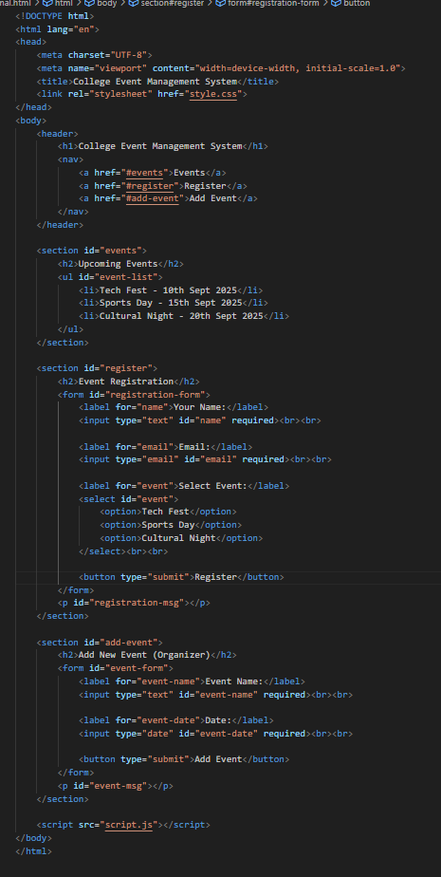
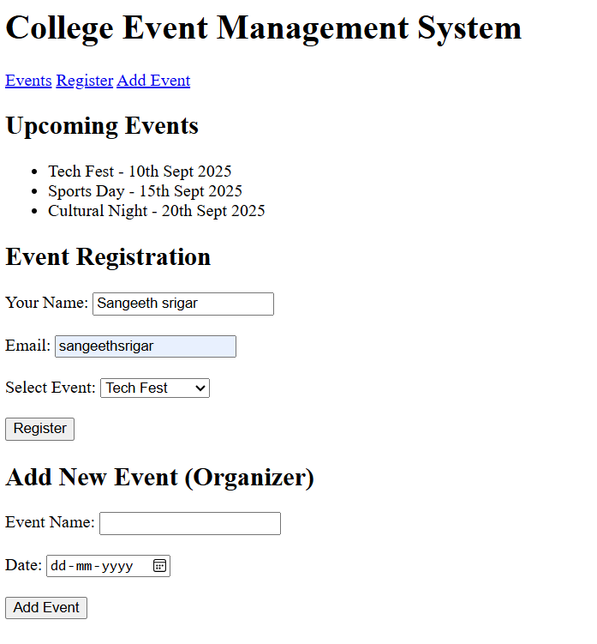
RESULTS AND SCREENSHOTS
10

Slide 11
CONCLUSION
In conclusion, the College Event Management System provides an efficient and user-friendly platform for organizing, managing, and participating in college events. By automating event registration, scheduling, notifications, and feedback collection, the system reduces manual effort and ensures smooth coordination among students, faculty, and organizers. It not only enhances communication and participation but also enables administrators to monitor event performance through reports and analytics. Additionally, the system improves transparency in event management and helps in maintaining accurate records of all activities. Furthermore, it encourages greater student engagement by making event information easily accessible and participation hassle-free. Overall, this system contributes to a more organized, interactive, and engaging campus environment, making event management simpler, faster, and more effective.
11

